Slide 1




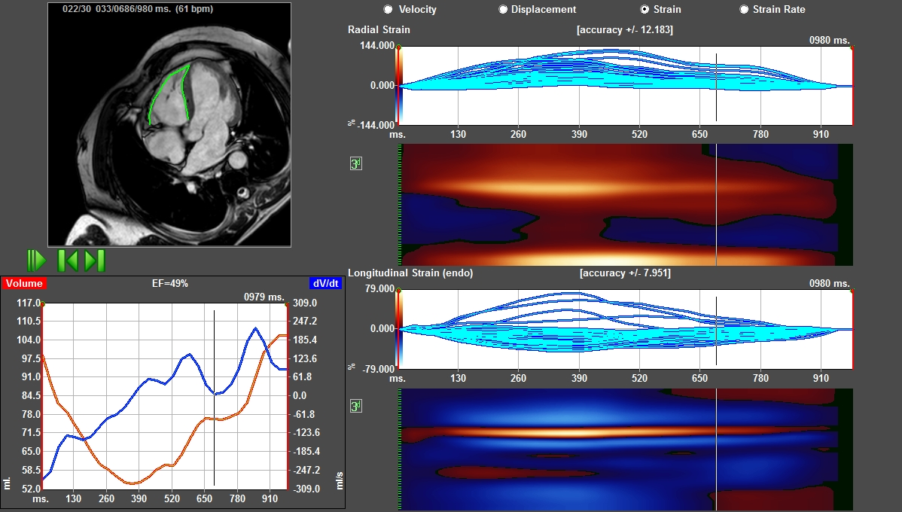
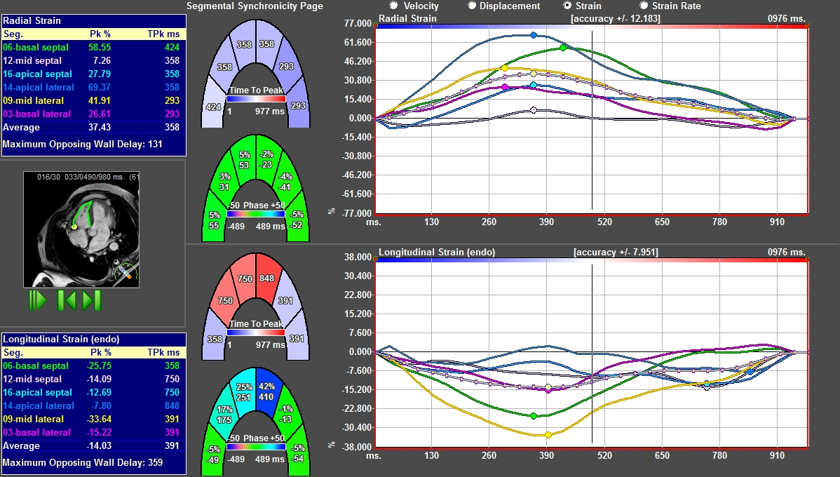
Right Ventricular Longitudinal Strain based on Magnetic Resonance Feature Tracking
in Patients with Arrhythmogenic Right Ventricular Cardiomyopathy
Meriam Åström Aneq¹, Eva Maret³ ,Jan Engvall^{1,2}
1. Department of Clinical Physiology and Department of Medical and Health Sciences, Linköping University, Linköping, Sweden
2. Center for Medical Image Science and Visualization (CMIV), Linköping University, Linköping, Sweden
3. Department of clinical Physiology, Karolinska University Hospital, Stockholm, Sweden
Introduction
Results
Arrhythmogenic right ventricular cardiomyopathy (ARVC) is characterized by dilatation and fibro-fatty substitution of the myocardium in the right ventricle (RV). Cardiovascular magnetic resonance imaging (CMR) is the gold standard for visualization and volume quantification of the RV, but the assessment of wall motion is still based on qualitative “eye-balling”. Previous studies have shown the successful application of feature tracking (CMR-FT) to the left ventricle.
The aim of this study was to test the feasibility of CMR-FT to assess RV strain in patients with ARVC and in healthy controls.
.
RV end systolic volume was significantly higher and ejection fraction lower in patients than in controls. Longitudinal strain decreased from base to apex in both groups (table 1). In a wall based analysis, the absolute strain values were significantly lower in patient lateral and anterior walls but not in inferior and septal walls. Global longitudinal strain was -23% in patients and -26% in controls (p=0,05).
 | ARVC | Control | P
EF (%) | 49 | 56 | 0,01*
RV end systolic volume (ml) | 104 | 82 | 0,002*
Strain base (%) | -25 | -31 | 0,005*
Strain mid (%) | -22 | -24 | ns
Strain apex (%) | -19 | -20 | ns
Strain lateral wall (%) | -24 | -32 | 0,02*
Strain anterior wall (%) | -22 | -28 | 0,01*
Strain inferior wall (%) | -26 | -27 | ns
Strain septal wall (%) | -15 | -18 | ns
Methods
Table 1: The right ventricular ejection fraction and segmental longitudinal strain values
Thirteen patients fulfilling Task Force Criteria for ARVC and twenty healthy subjects 46,6 yrs ±14,3 and twenty healthy subjects (38,5yrs ±16,3) underwent cardiac MRI at 1,5 Tesla. Steady-state free precession cine of six long axis slices was acquired by rotating the cut planes around the long axis of the RV. The 3-, 4- and 2-chamber views of the RV were identified. Segmental longitudinal strain was measured and re-calculated in terms of regional strain for the base (B), mid (M) and apical (A) levels of the RV and for the anterior, inferior, septal and free walls.
Conclusions
Feature tracking was successfully applied to cine MRI of the RV in this cohort of ARVC patients. Longitudinal absolute strain was lower in the basal segments, the anterior and the free walls compared to controls. This supports previous reports on the uneven regional distribution of ARVC.
Fig 1. Feature tracking in the long axis four chamber view of the RV in ARVC
Fig 2 RV longitudinal 4 chamber view,. Segmental radial strain (upper panel ) and segmental longitudinal strain (lower panel) in patient with ARVC
Contact information: Meriam Åström Aneq, MD, PhD (meriam.astrom.aneq@lio.se)

Slide 2



Magnetic resonance feature tracking for the determination of right ventricular longitudinal strain
Meriam Åström Aneq¹, Eva Maret³, Jan Engvall^{1,2}
1. Dpt of Clinical Physiology and Dpt of Medical and Health Sciences, Linköping University, Linköping, Sweden
2. Center for Medical Image Science and Visualization (CMIV), Linköping University, Linköping, Sweden
3. Department of Clinical Physiology, Karolinska University Hospital, Stockholm, Sweden
Euro-CMR 2014

Slide 3
INTRODUCTION
Arrhythmogenic right ventricular cardiomyopathy (ARVC) can lead to dilatation and dysfunction of the right ventricle (RV) due to fibro fatty replacement of the myocardium. The left ventricle (LV) can be engaged later in the process.
Cardiovascular magnetic resonance imaging based feature tracking (CMR-FT, TomTec, Germany) has been primarily developed for analysis of left ventricular function.
Our aim was to test the feasibility of CMR-FT to assess RV longitudinal strain in patients with ARVC.

Slide 4
Methods
Thirteen patients fulfilling Task Force Criteria for ARVC (46,6yrs ±14,8) and twenty healthy subjects (38,5yrs ±16,3) were included in the study and underwent cardiac MRI.
Six long axis slices of the RV were acquired by rotating the cut planes around the long axis.
The 3-, 4- and 2 chamber views of the RV were analysed.
Notes:
Kanske någon bild här?

Slide 5
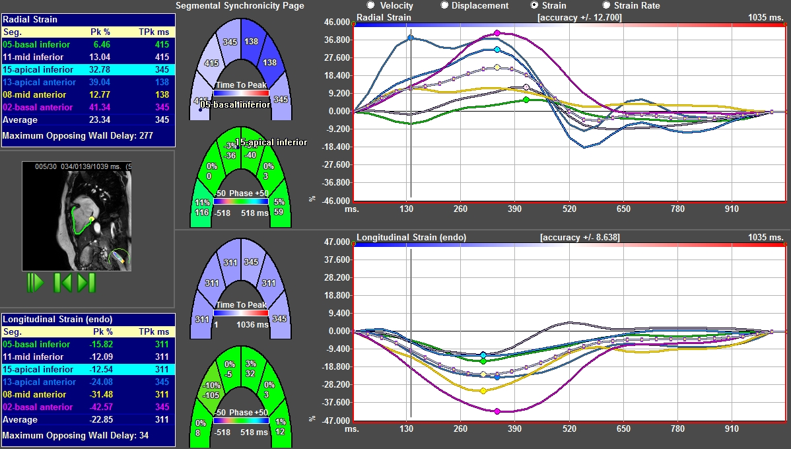
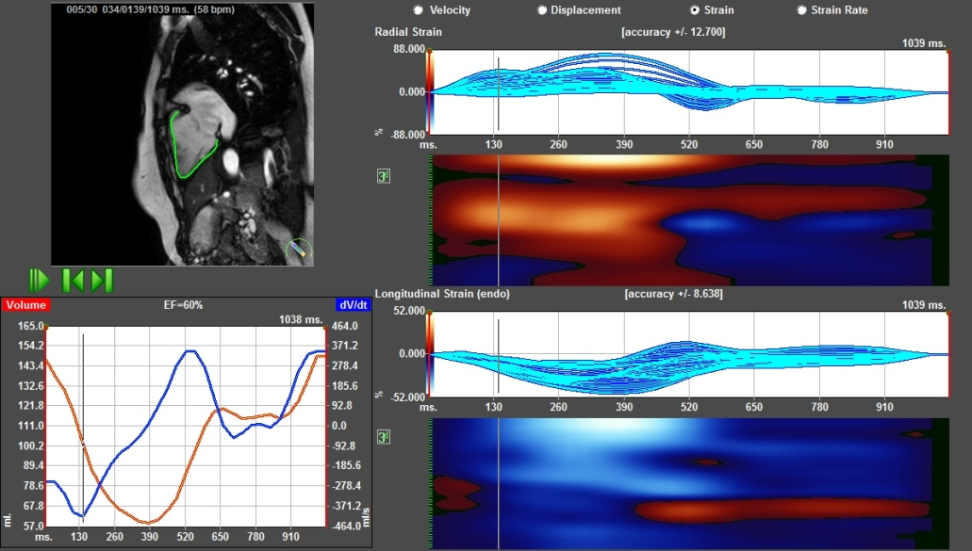
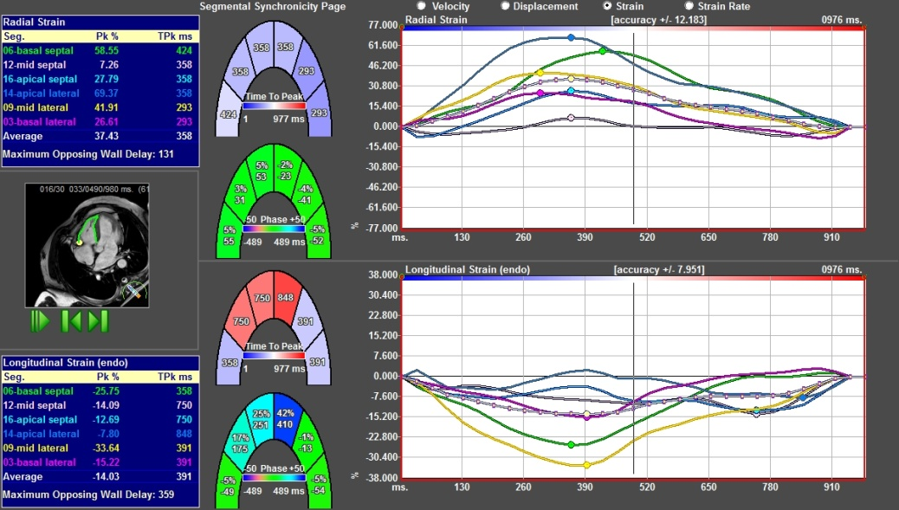

Fig 1.RV segmental radial and longitudinal strain in the 2 chamber view in a healthy control
Fig 2. RV segmental radial and longitudinal strain in the apical 4 chamber view in a patient with ARVC
Fig 2, shows strain in longitudinal 4chamber view, , both radial (upper panel ) and longitudinal (lower panel) in patient with ARVC
Notes:
Jag har flyttat denna bild från 5 till 4

Slide 6
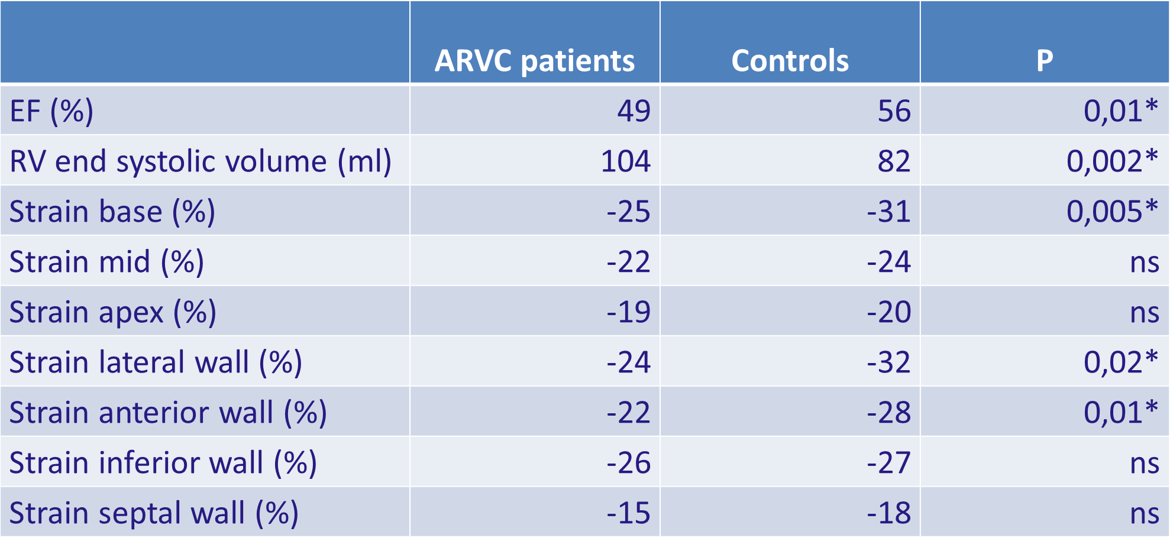
RESULTS
Compared to controls, RV end diastolic volume was not significantly different in ARVC patients and controls (201 vs 182 ml; p= 0,1).
End systolic volume was higher and ejection fraction lower in ARVC patients (104 vs 82 ml, 49 vs 56%).
Additionally, we found significantly lower segmental longitudinal strain in some of the segments in the ARVC patient group than in the healthy subjects.
Table 1: The right ventricular ejection fraction and segmental longitudinal strain values
Notes:
Kan man färgmarkera det som är intressant i tabellen, tex EF (varför finns inte volymen i tabellen?) Vill du lyfta fram några strainmått också??

Slide 7
CONCLUSION
This study shows that strain based on feature tracking analysed on cine MRI was successfully applied to the RV in this cohort of ARVC patients
Longitudinal absolute strain was lower in the basal segments, the anterior and the free walls compared to controls

